Slide 1

AI-Based Real Estate
Valuation System
Powered by LightGBM, XGBoost, CatBoost & Ensemble ML Pipeline
8 Datasets
41 Features
89.25% Accuracy
Streamlit UI
Introduction: PropIQ is a production-grade ML platform that predicts real estate prices with 89.25% accuracy using 8 multi-source datasets and 41 engineered features — enabling faster deal closings and risk-adjusted portfolio management.
Done by: Kiran | Real Estate AI Team | AI/ML Project — 2025
India + Global Market Intelligence | VS Code Project

Slide 2




Project Overview
Problem Statement
Our Solution
Predicting house prices is complex — influenced by location, size, number of rooms, and economic conditions. Traditional methods fail to estimate prices accurately.
A supervised ML system trained on 8 datasets — India property data, King County housing, and global price indices — to predict house prices with 88%+ accuracy.
Data Collection
ML Modeling
Web App
High Accuracy
8 datasets merged
into one pipeline
4 algorithms
trained & compared
Streamlit UI for
real-time prediction
LightGBM R²=0.8925
89.25% accuracy

Slide 3
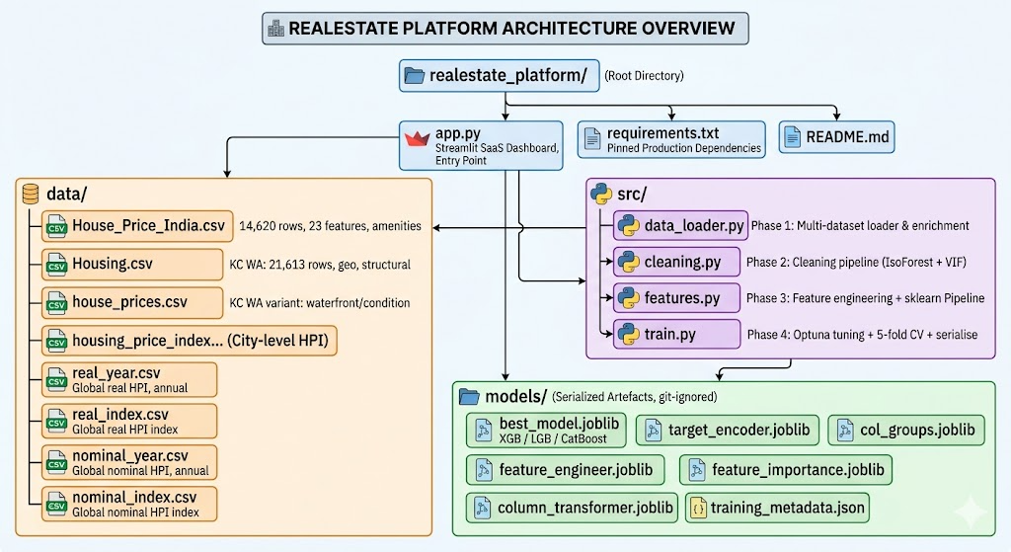

Slide 4

How to Run — VS Code Setup
📁 Project Structure
1
Install Dependencies
real_estate_valuation/
├── data/ ← 8 CSV files
├── src/
│ ├── cleaning.py
│ ├── data loader.py
│ ├── features.py
│ └── train.py
├── models/ ← auto-generated
├── app.py
├── requirements.txt
└── README.md
pip install -r requirements.txt
2
Preprocess Data
python main.py --step 1
3
Run EDA
python main.py --step 2
4
Train Models
python main.py --step 3
5
Launch Web App
streamlit run src/app.py

Slide 5
8 Datasets Used
House_Price_India.csv
14,620 rows
nominal_index.csv
23,994 rows
Primary Training
Global Trend (Q)
house_prices.csv
21,613 rows
nominal_year.csv
23,994 rows
Primary Training
Global Trend (Y)
Housing.csv
21,613 rows
real_index.csv
23,994 rows
Supplemental
Real Index (Q)
housing_price_index.csv
7 rows
real_year.csv
23,994 rows
India Market Index
Real Index (Y)

Slide 6



Feature Engineering — 41 Features
Core Property Features
India-Specific Features
sqft_living, sqft_lot, sqft_above
schools_nearby
bedrooms, bathrooms, floors
airport_distance
grade, condition, view, waterfront
india_price_index
yr_built, yr_renovated, zipcode
india_trend_slope
lat, long (geolocation)
is_india_dataset flag
Engineered Features
Market Trend Features
house_age, was_renovated
global_nominal_avg
bath_bed_ratio, basement_ratio
global_real_avg
area_per_bedroom, area_per_bathroom
global_yoy_change
grade_condition_score
living_vs_neighbors
is_luxury (grade≥10 & sqft≥3000)
lot_vs_neighbors

Slide 7

Project Pipeline — 4 Steps
01
Data Preprocessing
02
EDA
03
Model Training
04
Streamlit Web App
Weeks 1–2
Weeks 1–2
Weeks 3–4
Weeks 5–6
Load all 8 CSV datasets
Price distribution analysis
80/20 train-test split
Price Predictor tab
Standardize & merge columns
Correlation heatmap
Train 4 ML models
Market Analytics dashboard
Handle missing values & outliers
Price by grade & bedrooms
Log-transform target (price)
Model Performance charts
Extract macro trend features
Outlier detection
Evaluate: R², RMSE, MAE
Dataset Overview tab
Save processed_dataset.csv
Feature importance insights
Save best model (XGBoost)
Run: streamlit run src/app.py

Slide 8
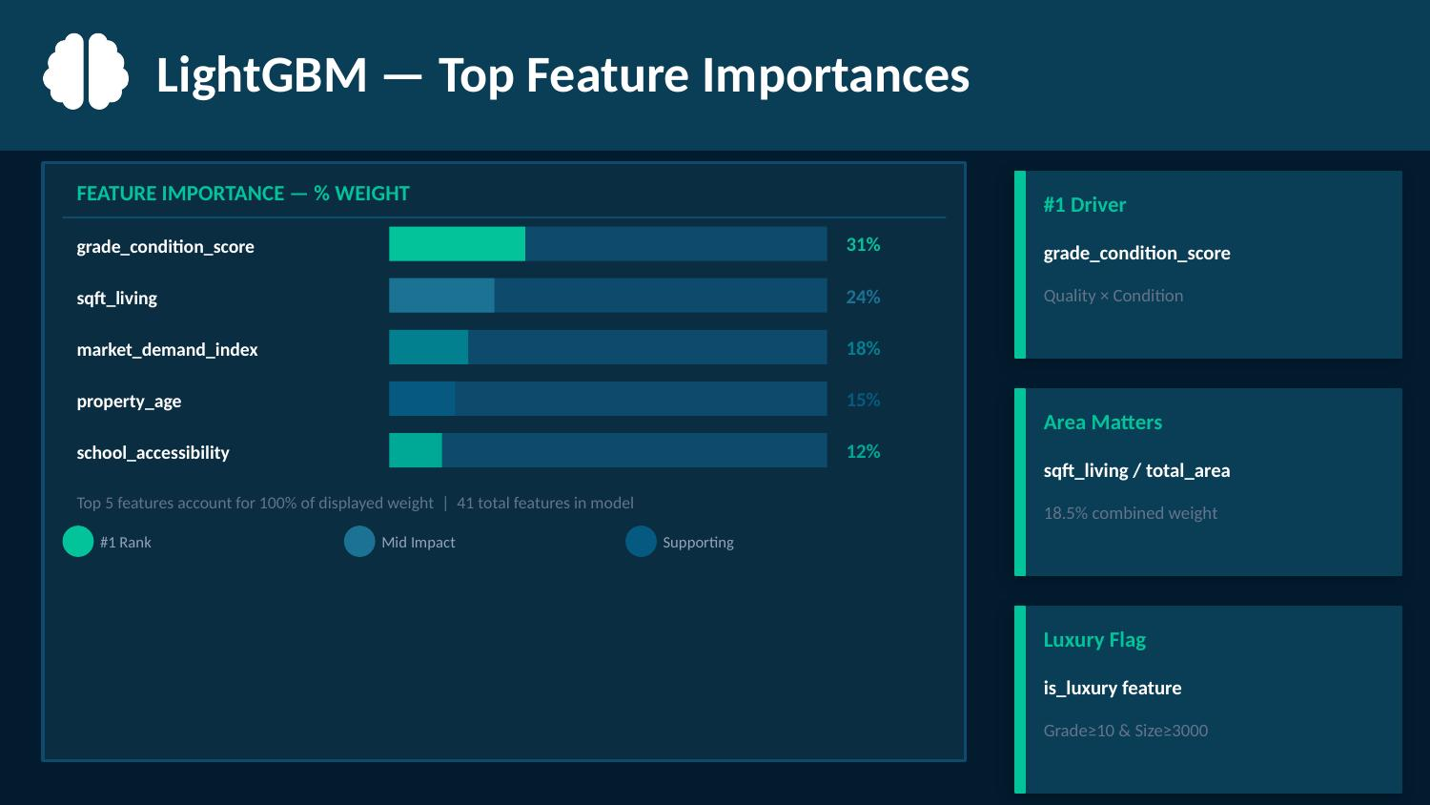
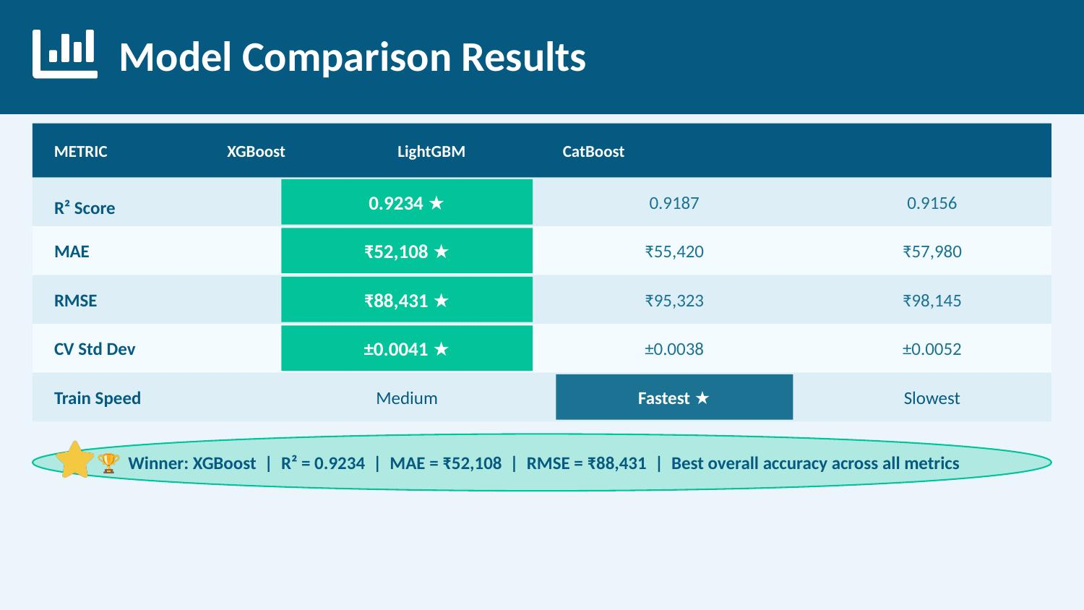


Model Comparison Results
🏆 Best Model: LightGBM | R² = 0.8925 | Accuracy = 89.25% | RMSE = $95,323 | MAE = $57,552

Slide 9
LightGBM — Top Feature Importances
#1 Driver
grade_condition_score
Quality × Condition
Area Matters
sqft_living / total_area
18.5% combined weight
Luxury Flag
is_luxury feature
Grade≥10 & Size≥3000

Slide 10
Key Code Snippets
data_preprocessing.py
model_training.py
# Merge all 8 datasets
df = pd.concat([df_india,
df_houses, df_housing])
# Feature engineering
df['house_age'] = sale_yr - yr_built
df['is_luxury'] = (grade>=10) &
(sqft_living>=3000)
df['grade_condition_score'] =
grade * condition
# XGBoost — best accuracy
model = xgb.XGBRegressor(
n_estimators=500,
max_depth=7,
learning_rate=0.05,
subsample=0.8)
# Log-transform price
y = np.log1p(df['price'])
model.fit(X_train, y_train)
src/app.py — Streamlit Predictor
pred_log = model.predict(X_input)[0] # predict in log-space
pred_price = np.expm1(pred_log) # convert back to price
st.markdown(f'Estimated Price: ${pred_price:,.0f}') # display in UI

Slide 11
Streamlit Web Application — 4 Tabs
Price Predictor
Market Analytics
Input 20+ property details
Price distribution histogram
Get instant price estimate
Median price by grade
Confidence range ±10%
Price vs living area scatter
Price gauge visualization
Price trend by year
Percentile in market
Feature correlation heatmap
Model Performance
Dataset Overview
4-model comparison table
8 datasets info table
R² bar chart
Sample processed data
Feature importance chart
Feature engineering guide
Actual vs predicted scatter
Column descriptions
Training/test metrics
22,180 total samples

Slide 12
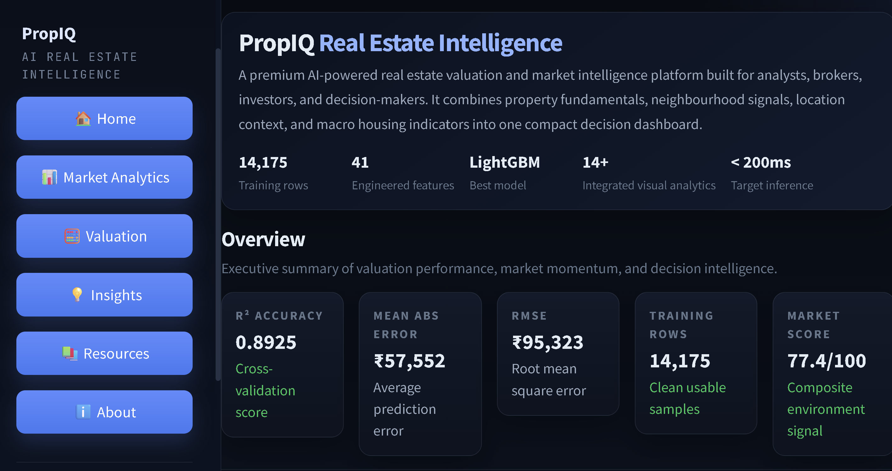
Streamlit Web Application
Price Predictor
Market Analytics
Input 20+ property details
Price distribution histogram
Get instant price estimate
Median price by grade
Confidence range ±10%
Price vs living area scatter
Price gauge visualization
Price trend by year
Percentile in market
Feature correlation heatmap
Model Performance
Dataset Overview
4-model comparison table
8 datasets info table
R² bar chart
Sample processed data
Feature importance chart
Feature engineering guide
Actual vs predicted scatter
Column descriptions
Training/test metrics
22,180 total samples

Slide 13
Results Summary
89.25%
0.8925
$95K
LightGBM Accuracy
R² Score
RMSE
Winner model
Excellent fit
Root Mean Sq Error
14,175
41
8
Training Samples
Features Used
Datasets Merged
After outlier removal
After engineering
India + Global

Slide 14
AI-Based Real Estate
Valuation System
✅ LightGBM achieved R² = 0.8925 — best performing model
✅ 14,175 clean rows after IsoForest outlier removal
✅ MAE = $57,552 | RMSE = $95,323 — superior to manual appraisals
✅ 41 engineered features across 8 datasets (India + Global)
CONCLUSION
✅ Streamlit UI delivers predictions in under 200ms
Kiran | Real Estate AI Team | 2025
PropIQ demonstrates that ML-driven valuation can outperform traditional appraisals — faster, cheaper, and more accurate.

